Slide 1

Newborn Heart Murmurs
Jessie Marks ARNP
Adapted slides by Karen Kilian, ARNP, CCRN, Seattle Children’s Hospital

Slide 2
Learning Objectives
Understand concerning cardiac symptoms
Understand management of newborn murmurs

Slide 3
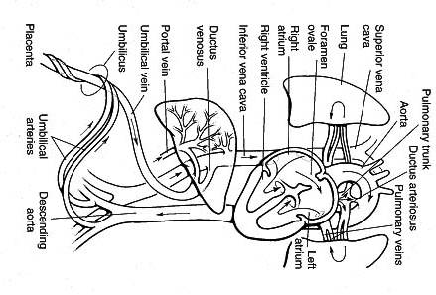
Fetal Versus Neonatal Circulation
Parameter | Fetal | Neonatal
Circuits | Parallel | Series
PVR | Pulmonary > systemic | Systemic > pulmonary
PO2 (mm Hg) | 15-25 UA 32-35 UV | >60
O2/CO2 exchange | Intervilllous space | Alveolus/capillary
Shunts | DV, DA,FO | none

Slide 4
Changes At Birth
Redistribution of cardiac output
Increased pulmonary blood flow
Changes in pulmonary-systemic pressures
Increased catacholamines
Ventricles begin working in series
Functional closure of fetal shunts
Changes in myocardial function
Notes:
these changes can lead to transient murmurs in newborns.
Pulmonary blood flow increases 8-10 fold
Changes in myocardial function may be mediated by epinephrine surge at birth (decreases by ~4 hours)

Slide 5
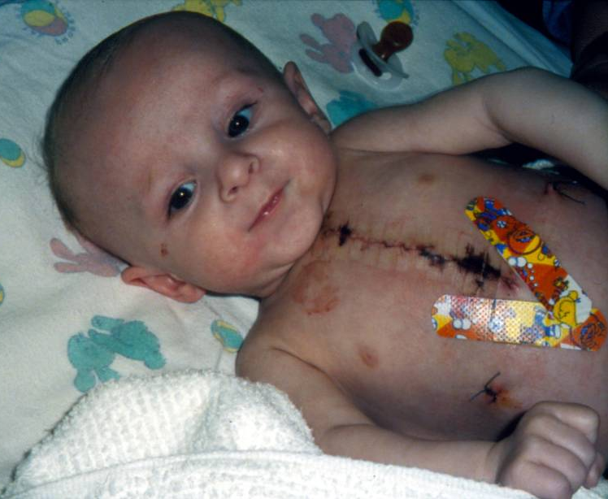
Congenital Heart Disease
The incidence of CHD varies between 4 to 50 per 1,000 live births.
For comparison:
Congenital deafness: 1 in 1000 infants
PKU: 1 in 13,500 to 19,000 infants
Notes:
205 echocardiograms done in neonatal nursery because of a murmur: major structural lesions were identified in 2% of them. Half were coarctation, 26% of the echoes were normal, 38% had defects like small VSD or atrial septal defect (ASD). Transient circulatory changes like patent ductus arteriosus, tricuspid regurgitation accounted for the other 34%. Singh A, Desai T, Miller P, Rasiah SV. Benefits of predischarge echocardiography service for postnatal heart murmurs. Acta Paediatr. 2012;101(8):e333-e336.

Slide 6
Classifications
●Cyanotic CHD – includes lesions that allow circulation of deoxygenated blood in the systemic circulation via intracardiac or extracardiac shunting
●Ductal-dependent CHD – Ductal-dependent congenital heart lesions are dependent upon a patent ductus arteriosus (PDA) to supply pulmonary or systemic blood flow or to allow adequate mixing between parallel circulations.
●Critical CHD – Critical CHD refers to lesions requiring surgery or catheter-based intervention in the first year of life. Critical CHD accounts for approximately 25 percent of all CHD.
Notes:
In critical right heart obstructive lesions, the PDA is necessary to supply blood flow to the lungs; in critical left heart lesions, the PDA supplies systemic circulation; and in parallel circulations (eg, transposition of the great arteries), bidirectional flow in the PDA allows mixing between oxygenated and deoxygenated circuits

Slide 7

Significant history associations with CHD
Family history of sudden cardiac death or hypertrophic cardiomyopathy
Family history of congenital heart disease
In utero exposure to medications or alcohol
Maternal diabetes mellitus
Preterm delivery
In uterine infection
Genetic Disorders
Aneuploidy (Trisomy 21, Turner syndrome)
Connective Tissue disorder
Inborn error of metabolism
Marfan syndrome
Feeding difficulty (shortened feeding times, multiple breaks)
Tachypnea
Fussiness
Color change either pallor or cyanosis
Sweating during feeding
Notes:
Trisomy 21
40-60% have a congenital heart defect
Williams Syndrome
Aortic stenosis, pulmonic stenosis

Slide 8
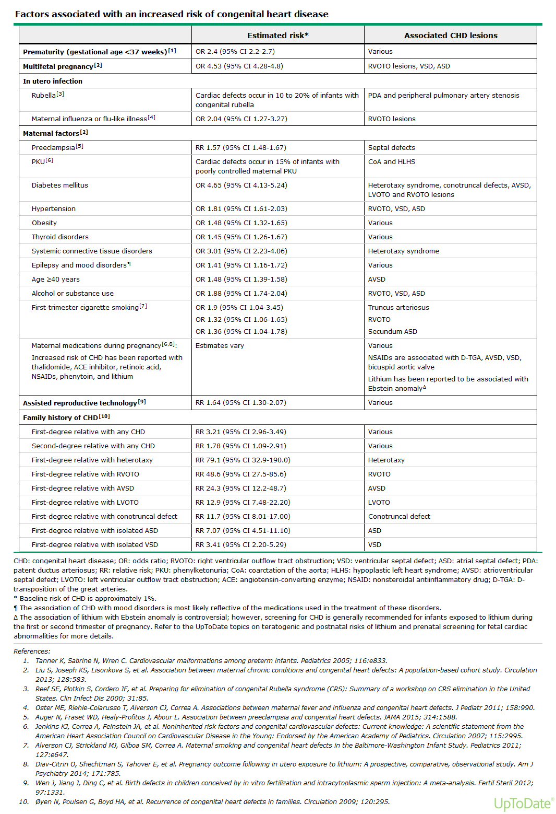

Slide 9
Murmurs
A murmur is a noise
May or may not be pathologic
Intensity will increase with fever, exercise, and excitement
Absence of a murmur does NOT indicate absence of congenital heart disease
Graded 1-6
1: Barely audible
2: Audible
3: Louder than a 2
4: You can FEEL it on the chest (thrill)
5: Louder than a 4
6: You can truly hear it without a stethoscope!

Slide 10
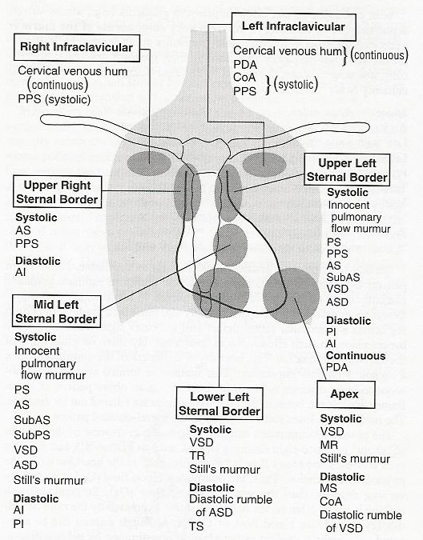
Murmurs

Slide 11
Innocent vs Pathologic Murmur
Innocent Murmur | Pathologic Murmur
Systolic only Usually little radiation | Diastolic – always pathologic Tend to be harsh quality Grade 2-3/6 Radiate Symptoms Fixed split S2

Slide 12
The Seven S’s: Key Features of Innocent Murmurs
Sensitive (changes with child’s position or with respiration)
Short duration (not holosystolic)
Single (no associated clicks or gallops)
Small (murmur limited to a small area and nonradiating)
Soft (low amplitude)
Sweet (not harsh sounding)
Systolic (occurs during and is limited to systole)
Notes:
Frank, J. E. and Jacobe, K. M. Evaluation and Management of Heart Murmurs in Children. Am Fam Physician. 2011;84(7):793- 800

Slide 13
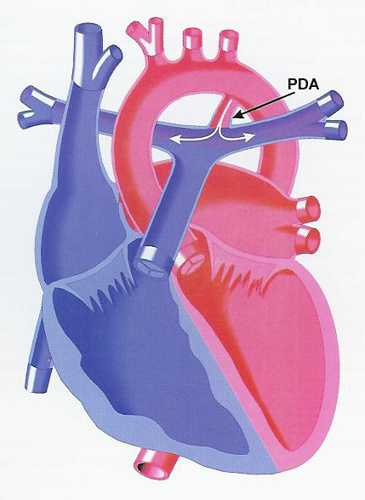
Patent ductus arteriosus: PDA
Should disappear in early newborn period
Continuous murmur (systolic and diastolic)
Loudest at upper left sternal border
Can be harsh in quality

Slide 14
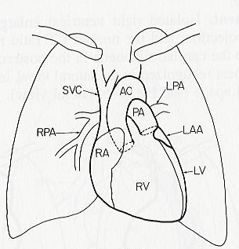
Murmurs: Branch PS
Branch pulmonary stenosis
Common in premature infants
KEY: noise radiates and is loudest at axilla, typically bilateral
Seldom persists beyond ages 3-6 months

Slide 15
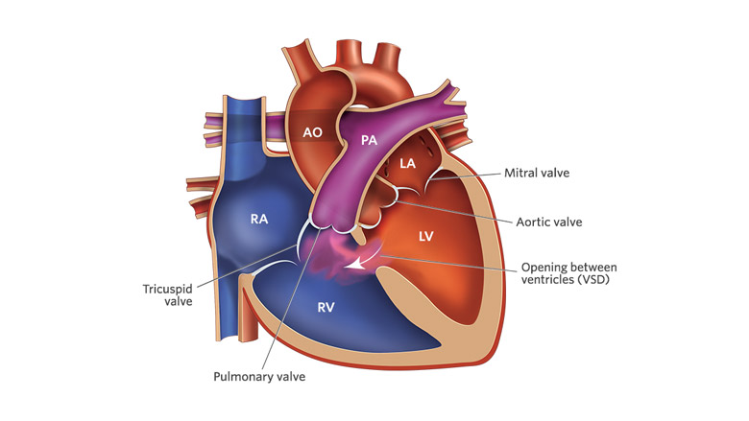
Ventral Septal Defect: VSD
A small ventricular septal defect may cause no problems, and many small VSDs close on their own.
Medium or larger VSDs may need surgical repair
Often heard day 2 or 3
Harsh jet-like quality and is systolic

Slide 16
CHD Management Approach
Symptomatic neonates
Urgent consultation/referral to a pediatric cardiologist should be made when CHD is suspected
Physical exam
Precordial activity
Heart sounds
Presence of murmur
Hepatomegaly
Diminished or absent lower extremity pulses
Abnormal 4 extremity BPs
2. CCHD screen
3. Chest radiograph- To help differentiate between cardiac and pulmonary disorders
4. EKG- Some cardiac lesions are associated with specific EKG patterns
5. Hyperoxia test- not necessary but can be done if ECHO not readily available
6. Echocardiogram
Asymptomatic neonates
1. History
2. Physical Exam evaluating for
Abnormal heart rate
Abnormal precordial activity
Abnormal S2 splitting
Extra heart sounds
Murmur
Hepatomegaly
Diminished pulses in LE
Notes:
Altman, CA., Fulton, DR., and Weisman, L. E. Identifying Newborns with critical congenital heart disease. Up To Date. Accessed May 2, 2021. https://www-uptodate-com.offcampus.lib.washington.edu/contents/identifying-newborns-with-critical-congenital-heart-disease?search=normal%20vs%20fetal%20heart%20physiology&topicRef=101291&source=see_link

Slide 17
Concerning Exam Findings
Any central cyanosis
Poor perfusion
Respiratory distress or tachypnea
Congenital anomalies
Decreased systemic perfusion (cool extremities, poor capillary refill, weak pulses)

Slide 18
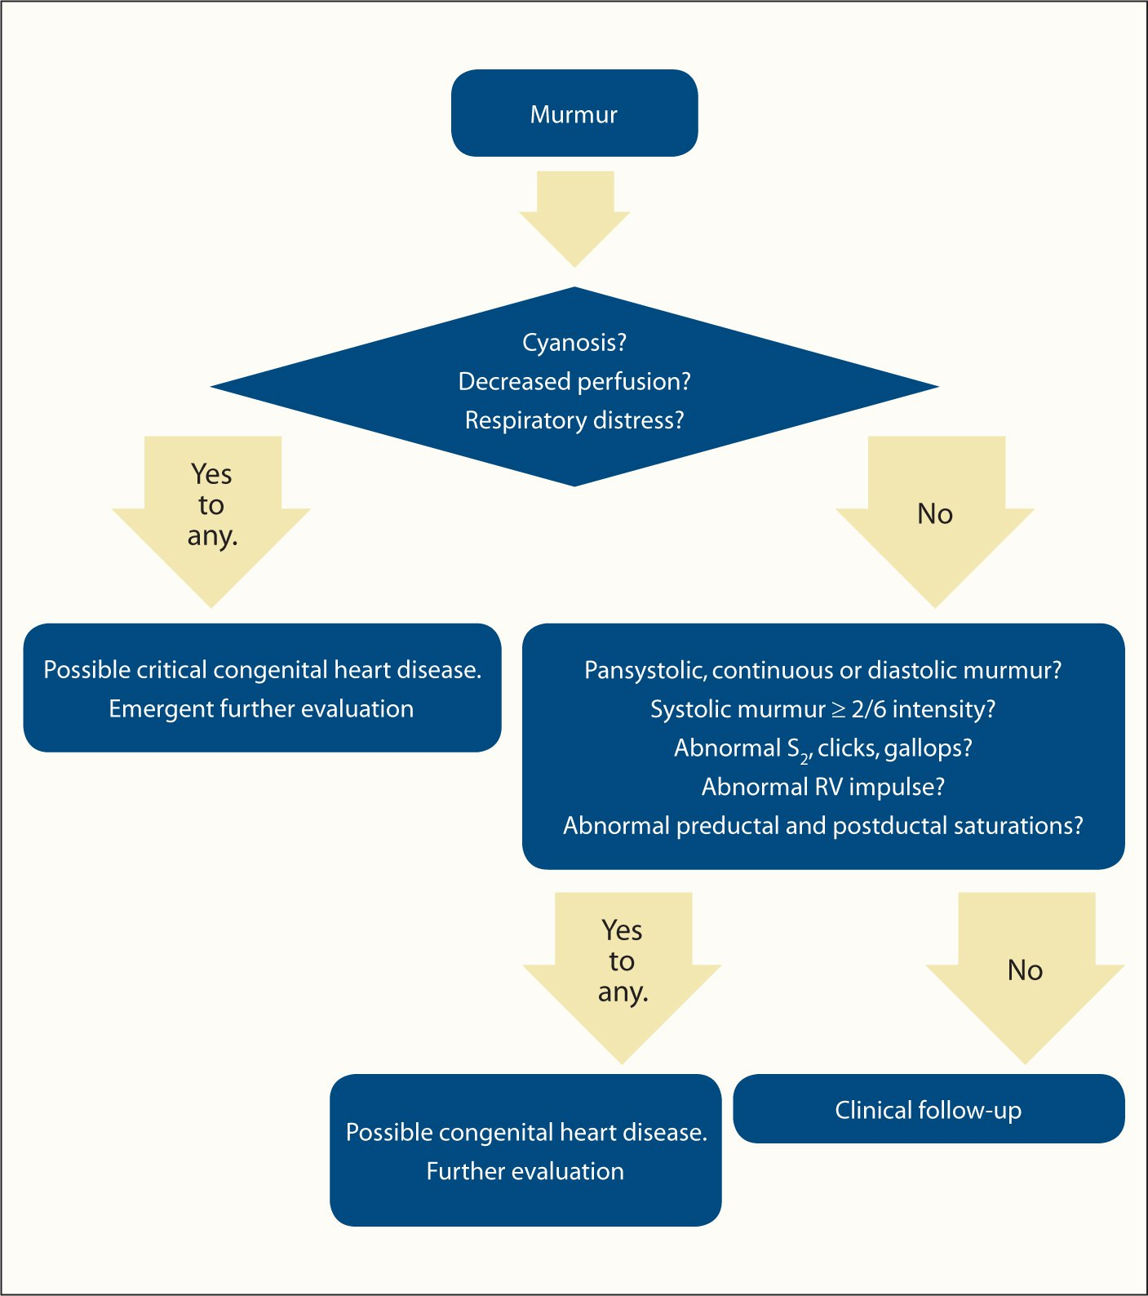
Notes:
Further evaluation meaning ECHO and consulting cardiology. Possible transfer to NICU.

Slide 19
References
Abdurrahman R et al. Pediatric Cardiology Update: Office-Based Practice of Pediatric Cardiology for the Primary Care Provider. Curr Probl Pediatr Adolesc Health Care. Nov/Dec. 2003. 318-347.
Everett AD & Lim DS. Illustrated Field Guide to Congenital Heart Disease and Repair, 2nd edition, revised. Scientific Software Solutions. 2007.
Kemper AR, Mahle WT et al. Strategies for Implementing Screening for Critical Congenital Heart Disease. Pediatrics. 2011. (128) e1259.
Park MK & Troxler RG. Pediatric Cardiology for Practitioners, 4th Edition. Mosby 2002.
Frank, J. E. and Jacobe, K. M. Evaluation and Management of Heart Murmurs in Children. Am Fam Physician. 2011;84(7):793- 800
Altman, CA., Fulton, DR., and Weisman, L. E. Identifying Newborns with critical congenital heart disease. Up To Date. Accessed May 2, 2021. https://www-uptodate-com.offcampus.lib.washington.edu/contents/identifying-newborns-with-critical-congenital-heart-disease?search=normal%20vs%20fetal%20heart%20physiology&topicRef=101291&source=see_link

